Slide 1
Investigating the 3rd Party Android Apps
Part 3
Notes:
https://digitalcorpora.s3.amazonaws.com/corpora/mobile/android_10/Non-Cellebrite%20Extraction/Pixel%203.zip

Slide 2

Investigating whatsapp

Slide 3
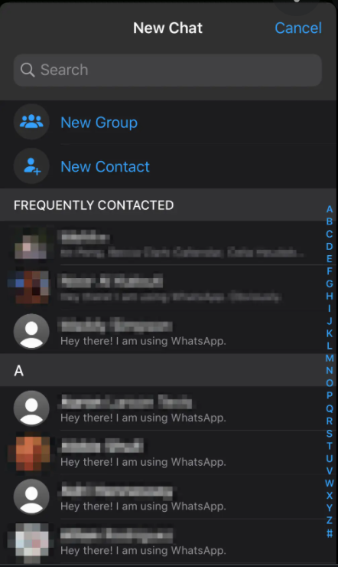
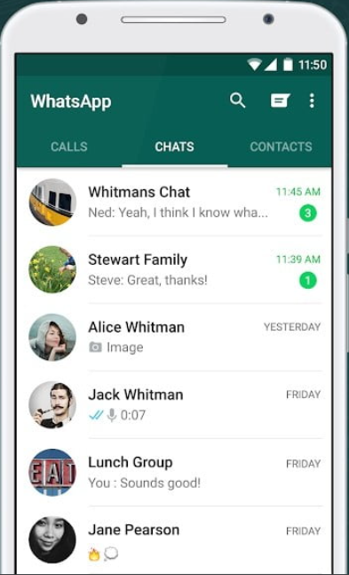
What is whatsapp?
WhatsApp is a free, multiplatform messaging app
Video and voice calls
Send images and text messages
Evidence types
Messages
Contacts
Phone numbers

Slide 4
Scenario
A suspect used WhatsApp app
Questions
Which phone number is associated with WhatsApp?
How many contacts are stored on WhatsApp?
Are there any conversations stored in the device?
Are we able to construct a timeline of the suspect’s behaviors?

Slide 5
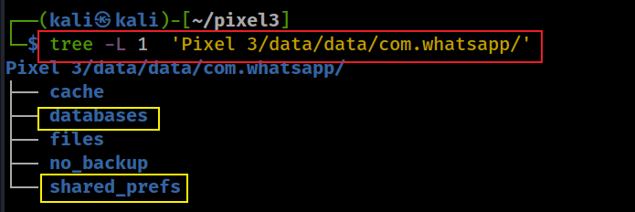
File structure of whatapp
Notes:
tree -L 1 'Pixel 3/data/data/com.whatsapp/'

Slide 6
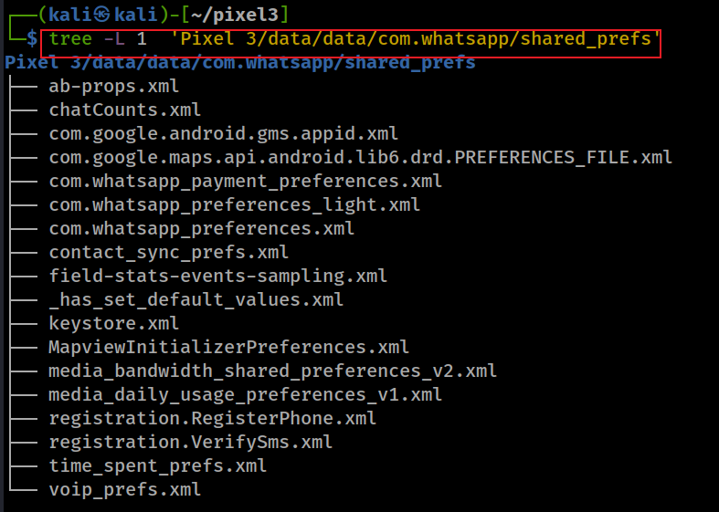
What phone number is associated with whatsapp?

Slide 7
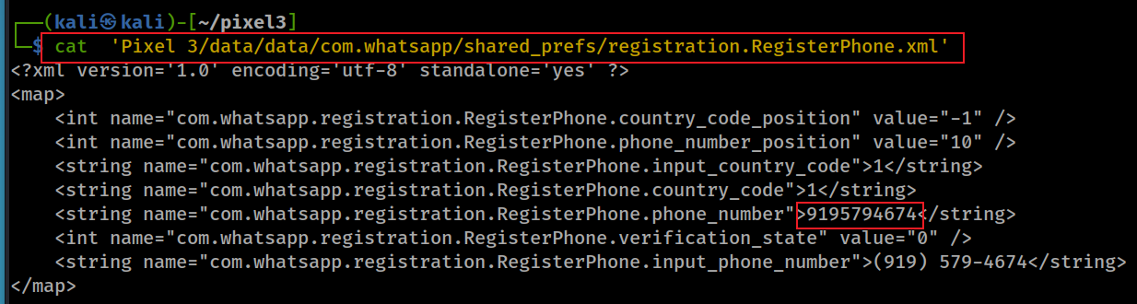
View one of preference files
Notes:
cat 'Pixel 3/data/data/com.whatsapp/shared_prefs/registration.RegisterPhone.xml'

Slide 8
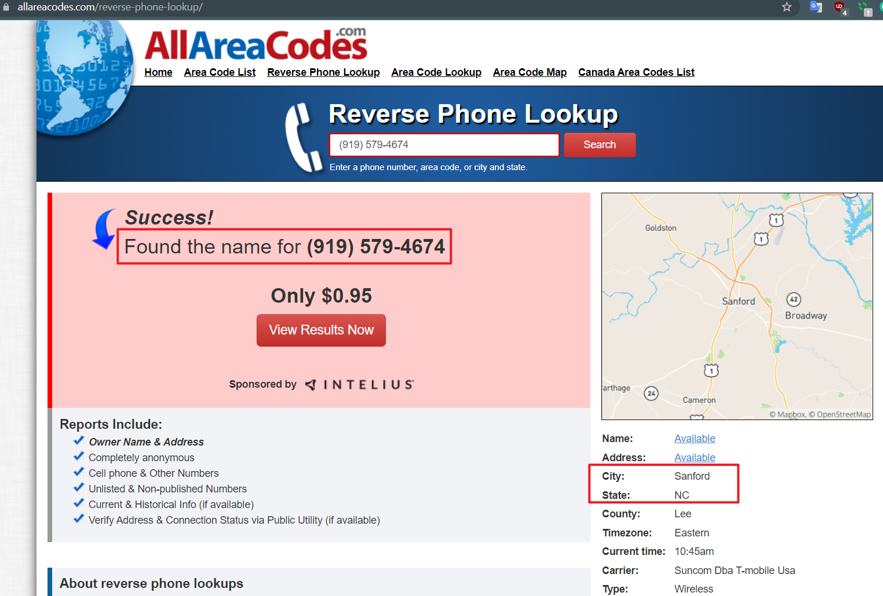

Slide 9




How many contacts are stored on whatsapp?
Structured information often stored in database, e.g., sqlite
An approach to investigate evidence in databases

Slide 10
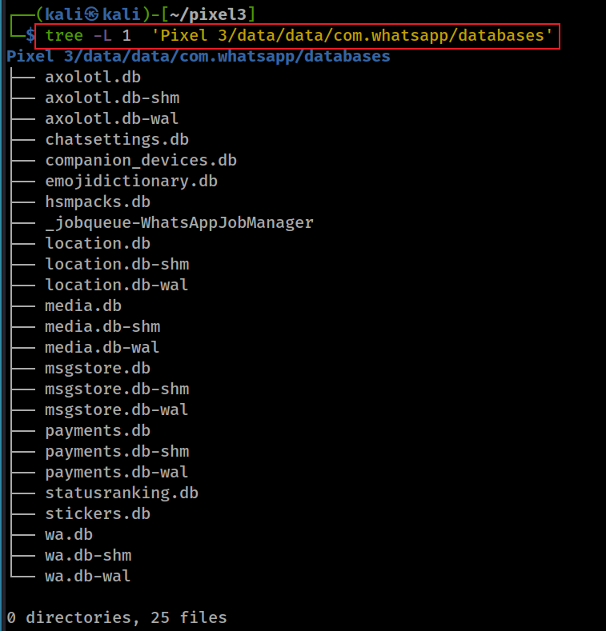
List all databases
Message store
contacts info
whatapp
Notes:
tree -L 1 'Pixel 3/data/data/com.whatsapp/databases'

Slide 11
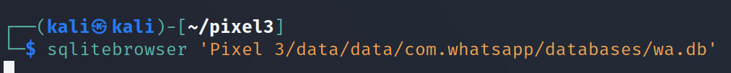
wa.db database (whatapp database)
Contains a full list of the WhatsApp user's contacts
phone numbers (blocked numbers, groups, etc.)
display names,
other information mentioned upon registering in WhatsApp
Show all tables in wa.db
Notes:
Cmd: sqlitebrowser 'Pixel 3/data/data/com.whatsapp/databases/wa.db'

Slide 12
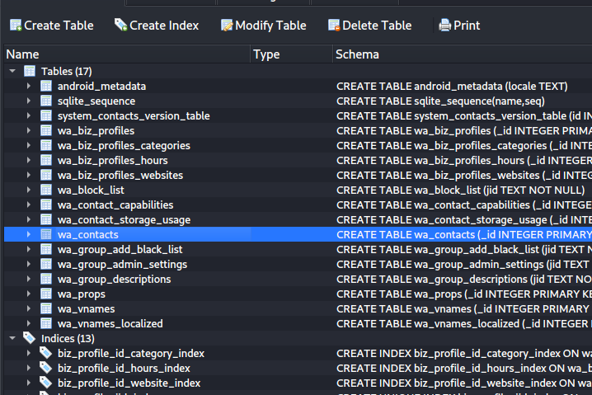
List all tables in wa.db databases

Slide 13
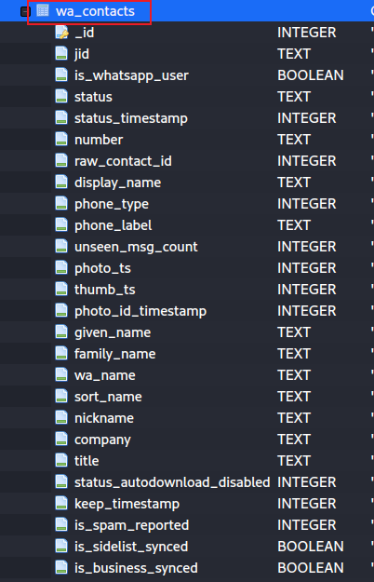
Show wa_contacts table

Slide 14
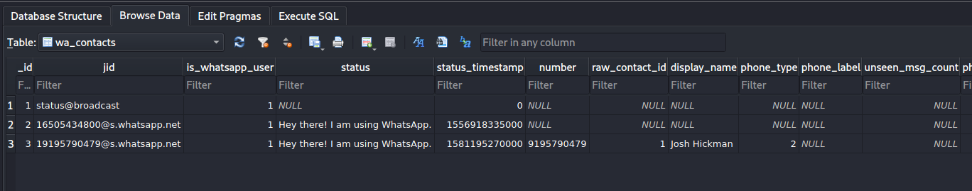
Show column information
contains ’1’ if the contact corresponds to an actual WhatsApp user, ’0’ otherwise
WhatsApp ID of the contact (a string structured as
’x@s.whatsapp.net’, where ’x’ is the phone number of the
contact)
Status set timestamp. Unix millisecond epoch time (13 digits)
status
name of contact
remember two IDs, will used for identify message contents
Notes:
https://arxiv.org/pdf/1507.07739.pdf

Slide 15
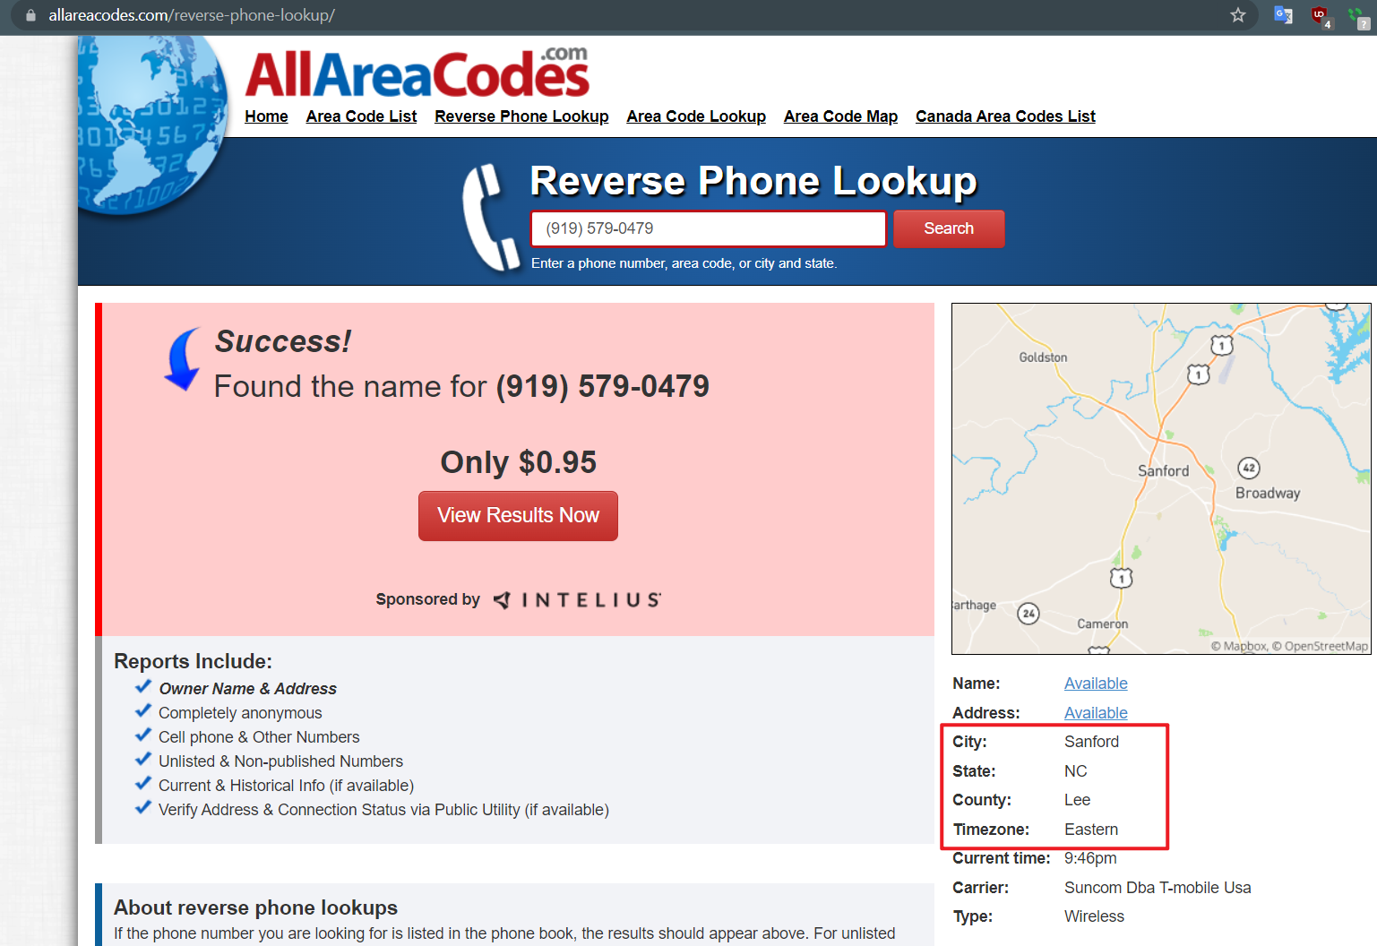
Notes:
https://www.allareacodes.com/919
(919) 579-0479

Slide 16
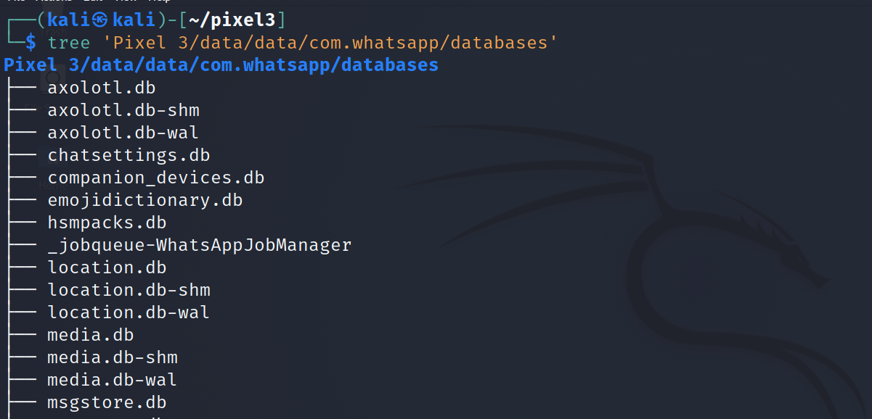
Are there any conversations stored in the device?
Look at the database list

Slide 17
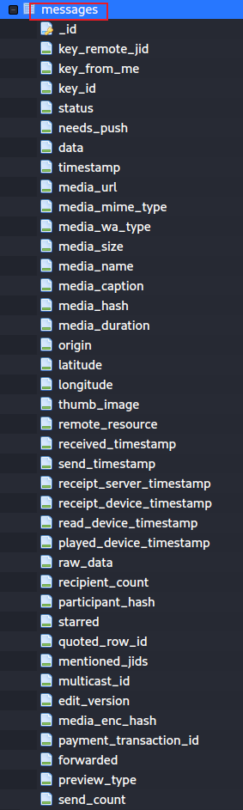
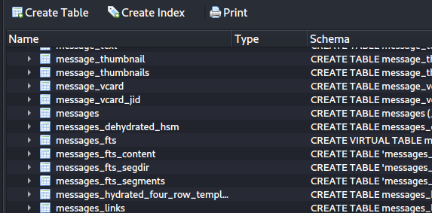
who the user communicates to
Open the database
send or receive
message content
media types (pic, msg, etc.)
time/duration
location
Notes:
sqlitebrowser 'Pixel 3/data/data/com.whatsapp/databases/msgstore.db'

Slide 18
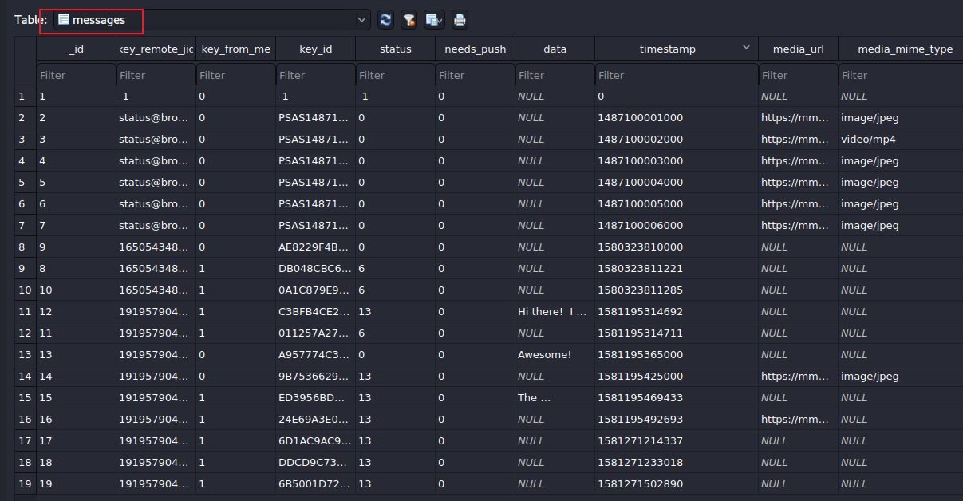
0=received
4=waiting on the server
5=received at the destination
6=control message
13=message opened by the recipient
message content
send/received timestamps
who
Notes:
other columns: https://blog.group-ib.com/whatsapp_forensic_artifacts

Slide 19
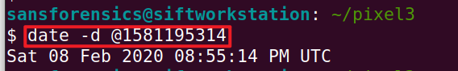
Note: UTC is 4 hours ahead of Eastern Time
Notes:
date -d @1581195314

Slide 20
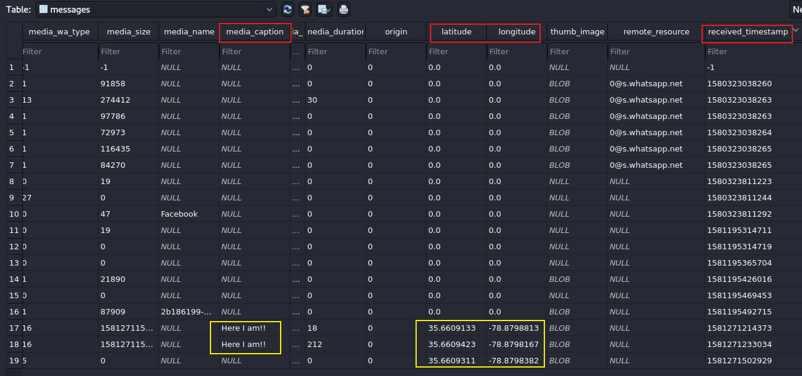
0: message
1: picture
5: static location
13: video
16: live location
Notes:
35.6609123, -78.8798813

Slide 21
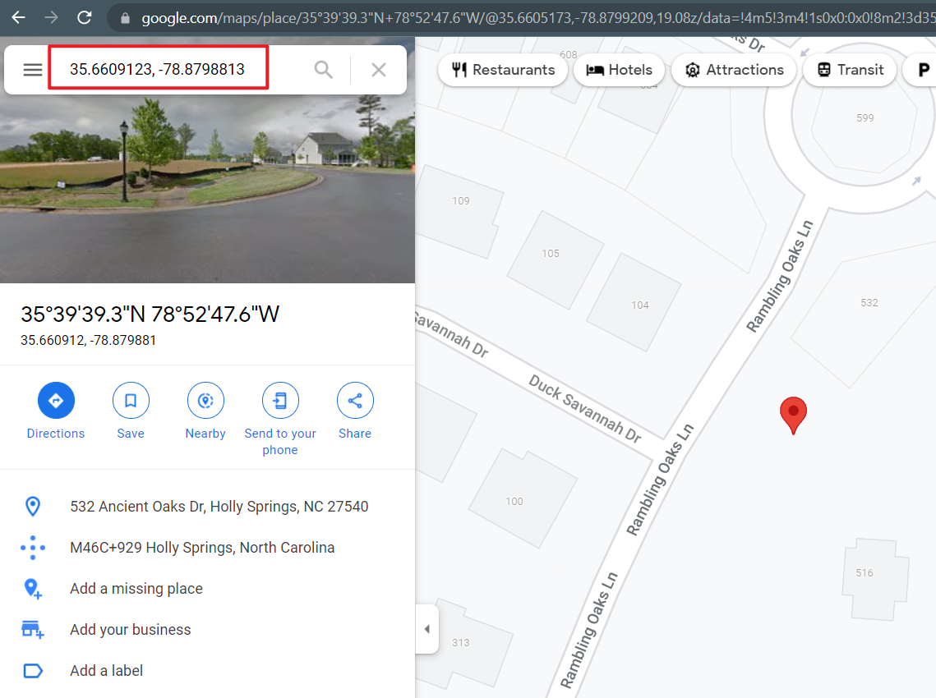
Notes:
https://www.google.com/maps/place/35%C2%B039'39.3%22N+78%C2%B052'47.6%22W/@35.6609133,-78.88207,17z/data=!3m1!4b1!4m5!3m4!1s0x0:0x0!8m2!3d35.6609133!4d-78.8798813

Slide 22
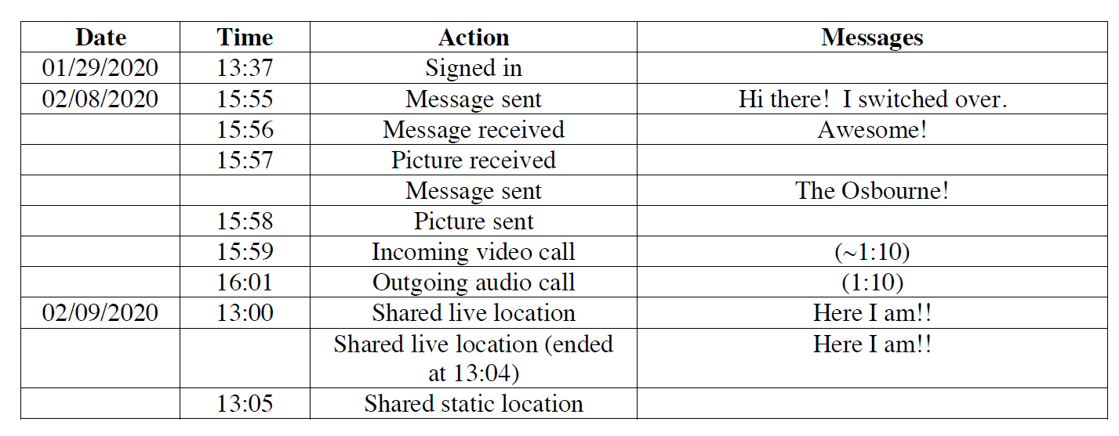
timestamps are one hour off?

Slide 23
To summarize
Dig into databases (msgstore.db & wa.db) to fetch information such as messages, contacts, etc
Find the phone number associated with WhatsApp
Questions: verify which columns are correct timestamps.

Slide 24
Homework (Snapshot)
Similar approach

Slide 25

Snapchat
Snapchat opens right to the camera, so you can send a Snap in seconds! Just take a photo or video, add a caption, and send it to your best friends and family. Express yourself with Filters, Lenses, Bitmojis, and all kinds of fun effects.
Evidence types
SNAP: camera
CHAT : messages
STORIES: friends' Stories, news, shows
SPOTLIGHT: best of Snapchat!
SNAP MAP: map
MEMORIES: look back on Snaps
FRIENDSHIP PROFILE: friends’ info
Notes:
https://play.google.com/store/apps/details?id=com.snapchat.android

Slide 26
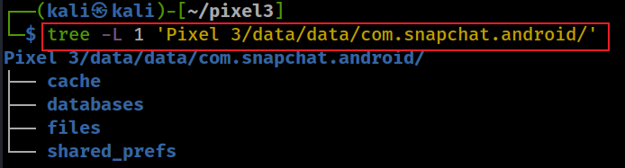
Snapchat level 1 file structure
Notes:
tree -L 1 'Pixel 3/data/data/com.snapchat.android/'

Slide 27
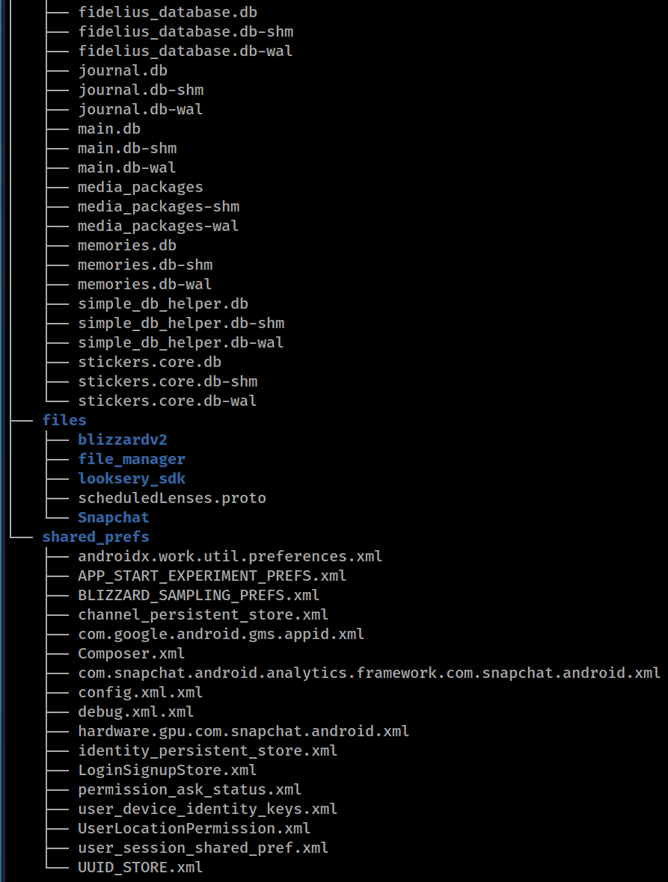
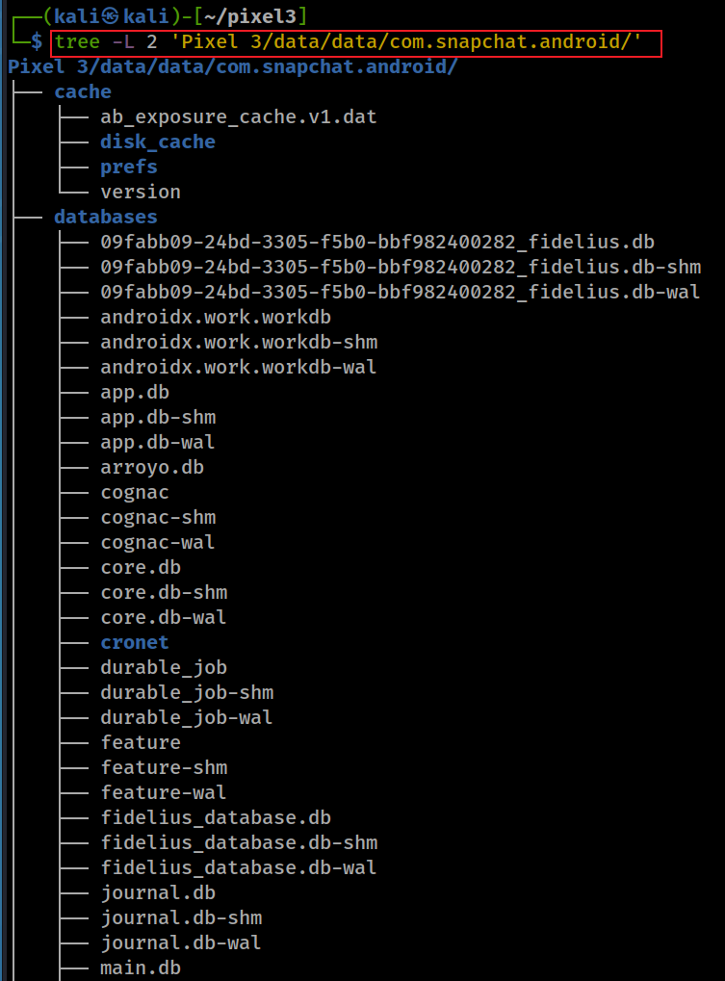
Snapchat level 2 file structure
Notes:
tree -L 2 'Pixel 3/data/data/com.snapchat.android/'

Slide 28
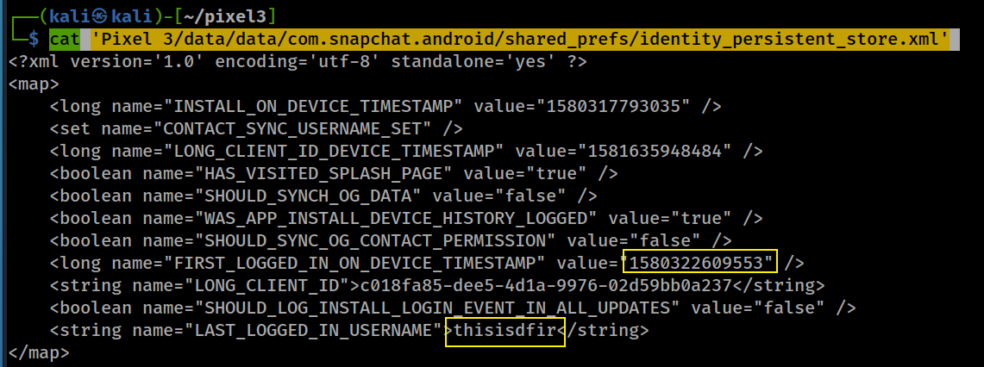
Who was the last logged in snapchat? data/data/com.snapchat.android/shared_prefs/identity_persistent_store.xml

Slide 29
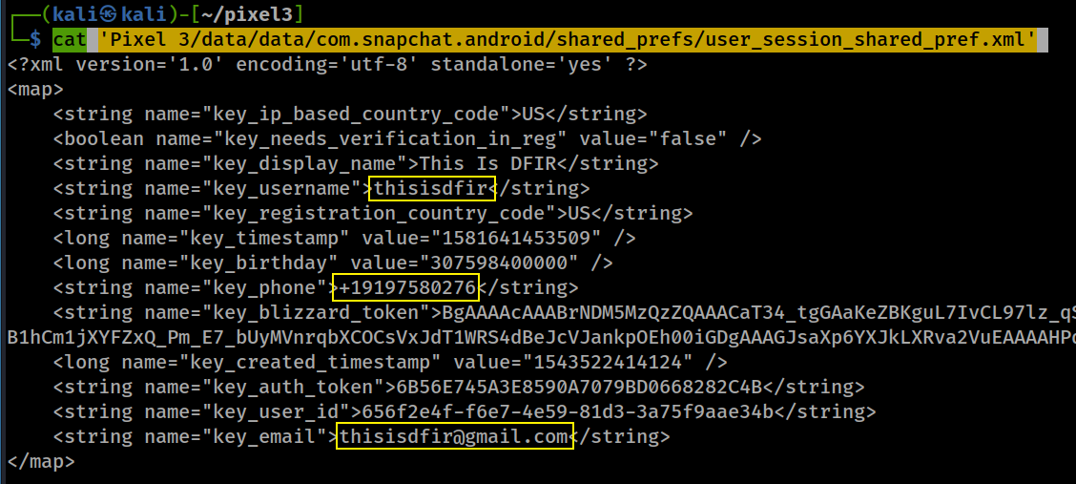
What is email/phone number of snapchat? data/data/com.snapchat.android/shared_prefs/user_session_shared_pref.xml
Notes:
cat 'Pixel 3/data/data/com.snapchat.android/shared_prefs/user_session_shared_pref.xml'

